Slide 1


Noida Institute of Engineering and Technology, Greater Noida
WEB DEVELOPMENT USING MEAN STACK
Unit: I
Introduction to Nodejs
Ritesh Kumar Singh
(Asst. Professor)
CSE Department
Course Details (B. Tech. 6th Sem)

Slide 2
Faculty Introduction
Name | Ritesh Kumar Singh
Qualification | Diploma, B.Tech., M. Tech., PhD. Pursuing
Designation | Assistant Professor
Department | Computer Science & Engineering
Total Experience | 5 years
NIET Experience | 4.5 years
Subject Taught | Web development using python with Django, Web Development using Mean Stack, Problem Solving using Advance Python, Problem Solving using Python, Programming for Problem Solving using C, Database Management System.

Slide 3
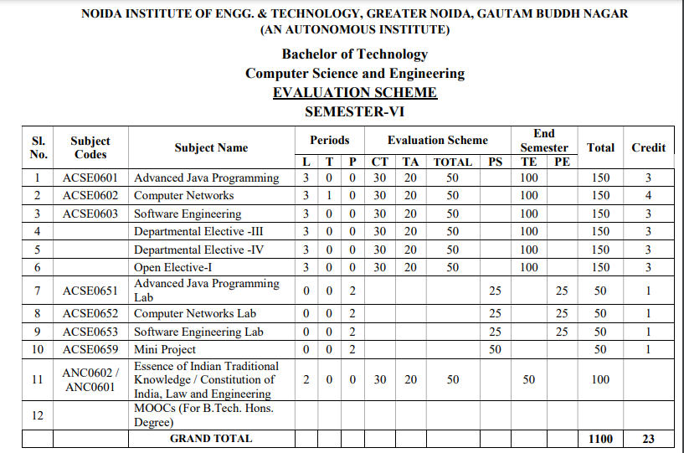
Evaluation Scheme

Slide 4
Syllabus
UNIT-I: Introduction to Nodejs
Installing Nodejs, Node in-built packages (buffer, fs, http, os, path, util, url)Node.js modules, File System Module, Json data, Http Server and Client, Error handling with appropriate HTTP, Callback function, asynchronous programing REST API’s(GET, POST PUT, DELETE UPDATE), Graph, Promises, Promise Chaining, Introduction to template engine (EJS).

Slide 5
Syllabus
UNIT-II: Express Framework
Configuring Express, Postman configuration, Environment Variables, Routing, Defining pug templates, HTTP method of Express, URL binding, middleware function, Serving static files, Express sessions, REST full API’s, FORM data in Express, document modeling with Mongoose.

Slide 6
Syllabus
UNIT-III: Basics of Angular js
Typescript, Setup and installation, Power of Types , Functions Function as types Optional and default parameters, Arrow functions, Function overloading, Access modifiers, Getters and setters, Read-only & static, Abstract classes, Interfaces, Extending and Implementing Interface, Import and Export modules.

Slide 7
Syllabus
UNIT-IV: Building Single Page App with Angular js
MVC Architecture, One-way and Two-way data binding, AngularJS Expressions, AngularJS Controllers, AngularJS Modules, adding controller to a module, Component, Dependency Injection, Filters, Tables, AngularJS Forms and Forms validation, Select using ng-option, AngularJS AJAX.

Slide 8
Syllabus
UNIT-V: Connecting Angular js with MongoDB
Environment Setup of Mongo dB , data modeling ,The current SQL/NoSQL landscape, Create collection in Mongo dB, CRUD Operations in MongoDB. Mongo's feature set, Introduction to Mongoose, understanding mongoose schemas and datatypes, Connecting Angular with mongo dB using API.

Slide 9
Branch Wise Application
1. Real time web analytics
2. Digital Advertising
3. E-Commerce
4. Publishing
5. Massively Multiplayer Online Games
6. Backend Services and Messaging
7. Project Management & Collaboration
8. Real time Monitoring Services
9.Live Charting and Graphing
10. Group and Private Chat

Slide 10
Course Objective
In this semester, the students will
Study how to design and build static as well as dynamic webpages and interactive web applications
Students examine advanced topics like Angular, nodejs, Mongodb for web applications.
Also examine Express framework for interactive web applications that use rich user interfaces .

Slide 11
Course Outcomes (COs)
At the end of course, the student will be able to:
CO1 : Explain, analyze and apply the role of server-side scripting language like Nodejs .
CO2 : Demonstrate Express framework to design and implement dynamic web pages.
CO3 : Apply the knowledge of Typescript that are vital in understanding angular js.
CO4 : Analyze build and develop single page application using client-side programming.
CO5 : Understand the impact of web designing by database connectivity with Mongodb

Slide 12
Program Outcomes (POs)
Engineering Graduates will be able to:
PO1 : Engineering Knowledge
PO2 : Problem Analysis
PO3 : Design/Development of solutions
PO4 : Conduct Investigations of complex problems
PO5 : Modern tool usage
PO6 : The engineer and society

Slide 13
Program Outcomes (POs)
Engineering Graduates will be able to:
PO7 : Environment and sustainability
PO8 : Ethics
PO9 : Individual and teamwork
PO10 : Communication
PO11 : Project management and finance
PO12 : Life-long learning

Slide 14
COs - POs Mapping
CO.K | PO1 | PO2 | PO3 | PO4 | PO5 | PO6 | PO7 | PO8 | PO9 | PO10 | PO11 | PO12
CO1 | 2 | 2 | 2 | 3 | 3 | - | - | - | - | - | - | -
CO2 | 3 | 2 | 3 | 2 | 3 | - | - | - | - | - | - | -
CO3 | 3 | 2 | 3 | 2 | 3 | - | - | - | - | - | - | -
CO4 | 3 | 2 | 3 | 2 | 3 | - | - | - | - | - | - | -
CO5 | 3 | 2 | 3 | 3 | 3 | - | - | - | - | - | - | -
AVG | 2.8 | 2.0 | 2.8 | 2.4 | 3.0 | - | - | - | - | - | - | -

Slide 15
Program Specific Outcomes(PSOs)
S. No. | Program Specific Outcomes (PSO) | PSO Description
1 | PSO1 | Understand to shows relationships and interactions between classes or objects of a pattern.
2 | PSO2 | Study to speed up the development process by providing well-tested, proven development
3 | PSO3 | Select a specific design pattern for the solution of a given design problem
4 | PSO4 | Create a catalogue entry for a simple design pattern whose purpose and application is understood.

Slide 16
COs - PSOs Mapping
CO.K | PSO1 | PSO2 | PSO3 | PSO4
CO1 | 3 | - | - | -
CO2 | 3 | 3 | - | -
CO3 | 3 | 3 | - | -
CO4 | 3 | 3 | - | -
CO5 | 3 | 3 | - | -

Slide 17
Program Educational Objectives (PEOs)
Program Educational Objectives (PEOs) | PEOs Description
PEOs | To have an excellent scientific and engineering breadth so as to comprehend, analyze, design and provide sustainable solutions for real-life problems using state-of-the-art technologies.
PEOs | To have a successful career in industries, to pursue higher studies or to support entrepreneurial endeavors and to face the global challenges.
PEOs | To have an effective communication skills, professional attitude, ethical values and a desire to learn specific knowledge in emerging trends, technologies for research, innovation and product development and contribution to society.
PEOs | To have life-long learning for up-skilling and re-skilling for successful professional career as engineer, scientist, entrepreneur and bureaucrat for betterment of society.

Slide 18
Result Analysis(Department Result & Subject Result & Individual result
Name of the faculty | Subject code | Result % of clear passed
Mr. Rahul Kumar | ACSE0614

Slide 19
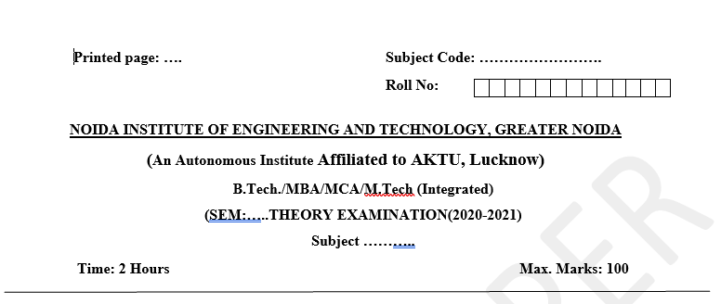
Pattern of Online External Exam Question Paper (100 marks)

Slide 20
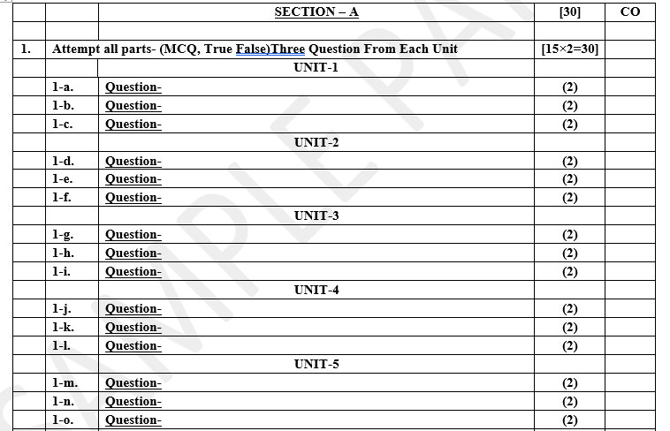
Pattern of Online External Exam Question Paper (100 marks)

Slide 21
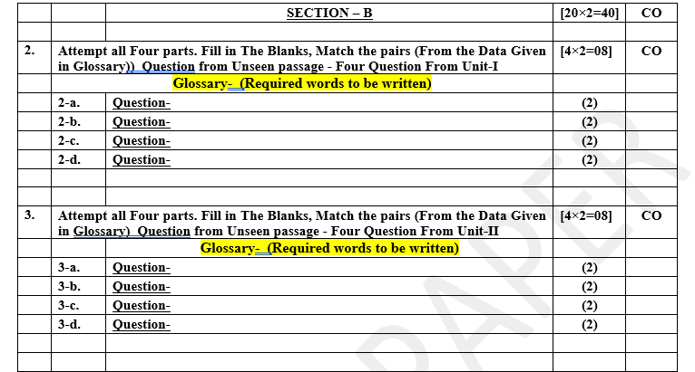
Pattern of Online External Exam Question Paper (100 marks)

Slide 22
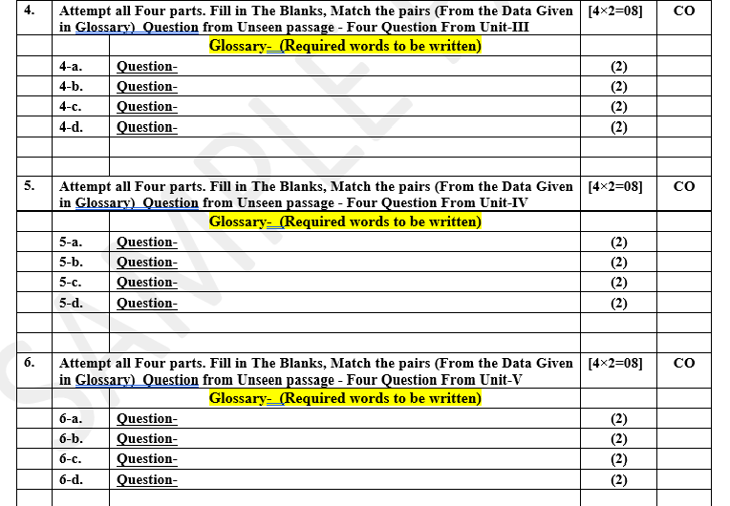
Pattern of Online External Exam Question Paper (100 marks)

Slide 23

Pattern of Online External Exam Question Paper (100 marks)

Slide 24
Prerequisite / Recap
Student should have knowledge of Web technology and terminology.
Knowledge of HTML ,CSS and Java Script required .
knowledge of Programing language such as C/C++/Python etc.
Good problem solving Skill .

Slide 25
Brief Introduction about the Subject with videos
YouTube /Other Video Links
https://youtu.be/BLl32FvcdVM
https://youtu.be/v9ejT8FO-7I?list=PLrhzvIcii6GNjpARdnO4ueTUAVR9eMBpc
https://youtu.be/VGLjQuEQgkI?list=PLt4nG7RVVk1h9lxOYSOGI9pcP3I5oblbx

Slide 26
Unit I Content
Installing Nodejs, Node in-built packages (buffer, fs, http, os, path, util, url)
Node.js modules, File System Module, Json data, Http Server and Client,
Error handling with appropriate HTTP, Callback function, asynchronous programing
REST API’s(GET, POST PUT, DELETE UPDATE),
Graph, Promises, Promise Chaining, Introduction to template engine (EJS).

Slide 27
Unit I Objective
In Unit I, the students will be able to find
Definitions of terms and concepts.
The idea of installation of node js.
How to handling Error handling with appropriate HTTP,
What is Callback function, asynchronous programing
Scope of development activity: applications, toolkits, frameworks.
Promise Chaining, Introduction to template engine (EJS) etc.

Slide 28
Topic Objective
Topic : Installing Nodejs, Node in-built packages (buffer, fs, http, os, path, util, url)
In this topic, the students will gain , how to install Nodejs , what are the built in packages used in the nodejs and many more.

Slide 29
Node Js - Overview
Node.js is an open-source, cross-platform JavaScript runtime environment and library for running web applications outside the client's browser. Ryan Dahl developed it in 2009, and its latest iteration, version 15.14, was released in April 2021.
Developers use Node.js to create server-side web applications, and it is perfect for data-intensive applications since it uses an asynchronous, event-driven model.

Slide 30
Node Js– Overview Cont………
Why Do We Use Node Js
Node Js is built on Google Chrome’s V8 engine, and for this reason its execution time is very fast and it runs very quickly.
There are more than 50,000 bundles available in the Node Package Manager and for that reason developers can import any of the packages any time according to their needed functionality for which a lot of time is saved.

Slide 31
Node Js – Overview Cont………
As Node Js do not need to wait for an API to return data , so for building real time and data intensive web applications, it is very useful. It is totally asynchronous in nature that means it is totally non-blocking.
The loading time for an audio or video is reduced by NodeJs because there is better synchronization of the code between the client and server for having the same code base.
As NodeJs is open-source and it is nothing but a JavaScript framework , so for the developers who are already used to JavaScript, for them starting developing their projects with NodeJs is very easy.

Slide 32
Node Js – Features
Features of Node Js
Asynchronous in Nature and Event driven: The servers made with the NodeJs never waits for the from an API. Without waiting for the data from the API, it directly moves to the next API. So all the APIs of NodeJS are totally non-blocking in nature. In order to receive and track all the responses of the previous API requests, it follows an event driven mechanism. Hence we can say that all the NodeJs API are non-blocking in nature.

Slide 33
Node Js – feature continue………
Single Threaded Architecture: With event looping, a single threaded architecture is followed by NodeJs and for this architecture makes Node Js more scalable. In contrast to other servers, limited threads are created by them for processing the requests. Whereas for the event driven mechanism, the NodeJS servers reply in a non-blocking or an asynchronous manner and for this reason NodeJS becomes more scalable. If we compare Node Js with other traditional servers like Apache HTTP servers, then we can say Node Js handles a larger number of requests. A single threaded program is followed by NodeJS and this allows NodeJs to process a huge amount of requests.

Slide 34
Node Js – Feature Cont………
Scalable: Nowadays, scalable software is demanded by most of the companies. One of the most pressing concerns in Software Development is addressed by NodeJs and that is scalability. Concurrent requests can be handled very efficiently using NodeJs. A cluster module is used by NodeJs for managing the load balancing for all the active CPU cores. The most appealing feature of NodeJs is that it can partition the applications horizontally and this partition procedure is mainly achieved by it due to the use of child processes.
Quick Execution time for code: V8 JavaScript runtime motor is used by NodeJs and this is also used by Google chrome. A wrapper is provided for the JavaScript by the hub and for that reason the runtime motor becomes faster and for this reason inside NodeJs, the preposition process of the requests also become faster.

Slide 35
Node Js– Feature Cont………
Compatibility on the cross platforms: Different types of systems like Windows, UNIX, LINUX, MacOS and other mobile devices can use NodeJs.
Fast Data Streaming: The processing time of the data that have been transmitted to different streams takes a long time. Whereas for processing the data, NodeJs takes a very short amount of time and it does it at a very fast rate. NodeJs saves a lot of time because the files are processed and uploaded simultaneously by NodeJs. So as a result, the overall speed of data and video streaming is improved by NodeJs.
No Buffering : The data is never buffered in NodeJs application.

Slide 36
Node Js – Installation
Step 1: Download the Installer
Download the Windows Installer from NodeJs official website. Make sure you have downloaded the latest version of NodeJs. It includes the NPM package manager.

Slide 37
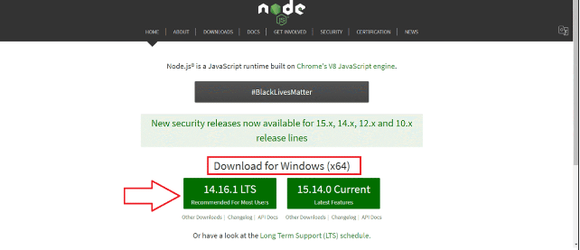
Node Js – Installation Cont………

Slide 38
Node Js – Installation Cont…..
Step 2: Install Node.js and NPM
After choosing the path, double-click to install .msi binary files to initiate the installation process. Then give access to run the application.
You will get a welcome message on your screen and click the “Next” button. The installation process will start.
Choose the desired path where you want to install Node.js.
By clicking on the Next button, you will get a custom page setup on the screen. Make sure you choose npm package manager , not the default of Node.js runtime . This way, we can install Node and NPM simultaneously.

Slide 39
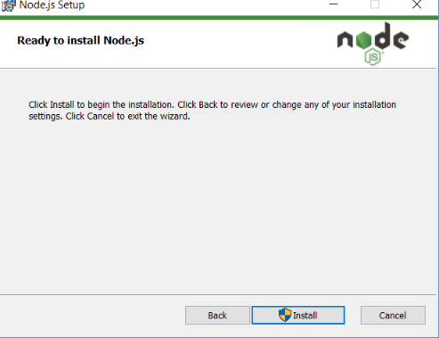
Node Js- Installation cont….
The setup is ready to install Node and NPM. Let’s click on the Install button .

Slide 40
Node in-build packages
Node.js has a set of built-in modules which you can use without any further installation.
Here is a list of the built-in modules of Node.js version 6.10.3:

Slide 41
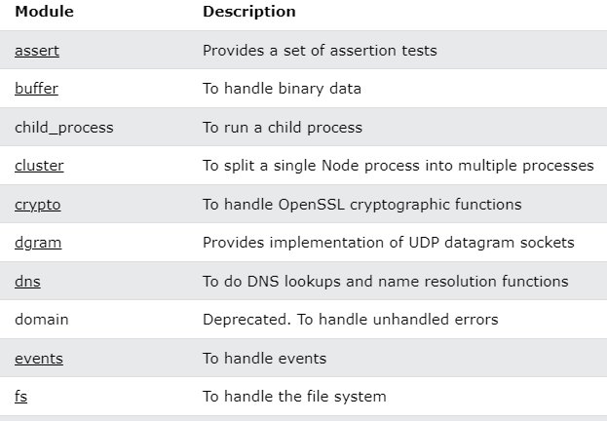
Node in-build packages

Slide 42
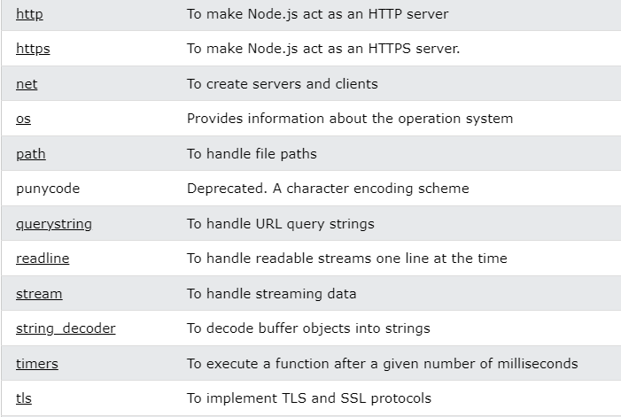
Node in-build packages

Slide 43
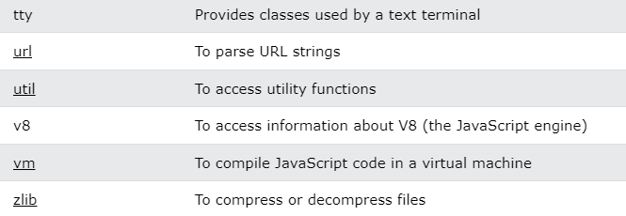
Node in-build packages

Slide 44
Node Js Modules
What is a Module in Node.js
Consider modules to be the same as JavaScript libraries.
A set of functions you want to include in your application.
Built-in Modules
Node.js has a set of built-in modules which you can use without any further installation.

Slide 45
Node Js Modules
Include Modules
To include a module, use the require() function with the name of the module:
var http = require('http');
Now your application has access to the HTTP module, and is able to create a server:
http.createServer(function (req, res) { res.writeHead(200, {'Content-Type': 'text/html'}); res.end('Hello World!'); }).listen(8080);

Slide 46
Node Js Modules
Node.js File System Module
Node.js as a File Server
The Node.js file system module allows you to work with the file system on your computer.
To include the File System module, use the require() method:
var fs = require('fs');
Common use for the File System module:
Read files
Create files
Update files
Delete files
Rename files

Slide 47
Node Js Modules
Read Files
The fs.readFile() method is used to read files on your computer.
Assume we have the following HTML file (located in the same folder as Node.js):
demofile1.html
<html> <body> <h1>My Header</h1> <p>My paragraph.</p> </body> </html>

Slide 48
Node Js Modules
Create a Node.js file that reads the HTML file, and return the content:
Example
var http = require('http'); var fs = require('fs'); http.createServer(function (req, res) { fs.readFile('demofile1.html', function(err, data) { res.writeHead(200, {'Content-Type': 'text/html'}); res.write(data); return res.end(); }); }).listen(8080);

Slide 49
Node Js Modules
Ceate Files
The File System module has methods for creating new files:
fs.appendFile()
fs.open()
fs.writeFile()
The fs.appendFile() method appends specified content to a file. If the file does not exist, the file will be created:
Example
Create a new file using the appendFile() method:
var fs = require('fs'); fs.appendFile('mynewfile1.txt', 'Hello content!', function (err) { if (err) throw err; console.log('Saved!'); });
Run example »

Slide 50
JSON Data
How to read and write JSON file using Node.js
Node.js is an open source and cross-platform runtime environment for executing JavaScript code outside of the browser. It is widely used in developing APIs and microservices from small to large companies.
JSON or JavaScript Object Notation is a light weight, text-based data interchange format. Like XML, it is one of the way of exchanging information between applications. This format of data is widely used by web applications/APIs to communicate with each other.

Slide 51
JSON Data
Reading a JSON file:
Method 1: Using require method: The simplest method to read a JSON file is to require it in a node.js file using require() method.
Syntax:
const data = require('path/to/file/filename');
Example: Create a users.json file in the same directory where index.js file present. Add following data to the json file.

Slide 52
JSON Data
[
{
"name": "John",
"age": 21,
"language": ["JavaScript", "PHP", "Python"]
},
{
"name": "Smith",
"age": 25,
"language": ["PHP", "Go", "JavaScript"]
}
]

Slide 53
JSON Data
Method 2: Using the fs module: We can also use node.js fs module to read a file. The fs module returns a file content in string format so we need to convert it into JSON format by using JSON.parse() in-built method. Add the following code into your index.js file: index.js file:

Slide 54
JSON Data
const fs = require("fs");
// Read users.json file
fs.readFile("users.json", function(err, data) {
// Check for errors
if (err) throw err;
// Converting to JSON
const users = JSON.parse(data);
console.log(users); // Print users
});

Slide 55
JSON Data
Writing to a JSON file: We can write data into a JSON file by using the node.js fs module. We can use writeFile method to write data into a file.
Syntax:
fs.writeFile("filename", data, callback);
Example: We will add a new user to the existing JSON file, we have created in the previous example. This task will be completed in three steps:
Read the file using one of the above methods.
Add the data using .push() method.
Write the new data to the file using JSON.stringify() method to convert data into string.

Slide 56
JSON Data
const fs = require("fs");
// STEP 1: Reading JSON file
const users = require("./users");
// Defining new user
let user = {
name: "New User",
age: 30,
language: ["PHP", "Go", "JavaScript"]
};
// STEP 2: Adding new data to users object
users.push(user);
// STEP 3: Writing to a file
fs.writeFile("users.json", JSON.stringify(users), err => {
// Checking for errors
if (err) throw err;
console.log("Done writing"); // Success
});

Slide 57
HTTP
An overview of HTTP
HTTP is a protocol for fetching resources such as HTML documents. It is the foundation of any data exchange on the Web and it is a client-server protocol, which means requests are initiated by the recipient, usually the Web browser. A complete document is reconstructed from the different sub-documents fetched, for instance, text, layout description, images, videos, scripts, and more.

Slide 58
HTTP
The Built-in HTTP Module
Node.js has a built-in module called HTTP, which allows Node.js to transfer data over the Hyper Text Transfer Protocol (HTTP).
To include the HTTP module, use the require() method:
var http = require('http');

Slide 59
HTTP
Node.js as a Web Server
The HTTP module can create an HTTP server that listens to server ports and gives a response back to the client.
Use the createServer() method to create an HTTP server:
Example
var http = require('http'); //create a server object: http.createServer(function (req, res) { res.write('Hello World!'); //write a response to the client res.end(); //end the }).listen(8080); //the server object listens on port 8080

Slide 60
Callback function
A callback is a function which is called when a task is completed, thus helps in preventing any kind of blocking and a callback function allows other code to run in the meantime.
Callback is called when task get completed and is asynchronous equivalent for a function.
Using Callback concept, Node.js can process a large number of requests without waiting for any function to return the result which makes Node.js highly scalable.
For example: In Node.js, when a function start reading file, it returns the control to execution environment immediately so that the next instruction can be executed. Once file I/O gets completed, callback function will get called to avoid blocking or wait for File I/O.

Slide 61
Callback function
Example 1: Code for reading a file synchronously (blocking code) in Node.js. Create a text file inputfile1.txt with the following content:
Hello Programmer!!! Learn NodeJS with GeeksforGeeks
// Write JavaScript code
var fs = require("fs");
var filedata = fs.readFileSync('inputfile1.txt');
console.log(filedata.toString());
console.log("End of Program execution");

Slide 62
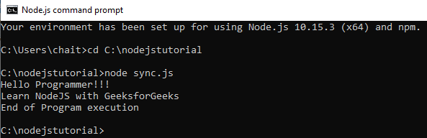
Callback function
Explanation: fs library is loaded to handle file-system related operations. The readFileSync() function is synchronous and blocks execution until finished. The function blocks the program until it reads the file and then only it proceeds to end the program.
Output:

Slide 63
Callback function
Example 2: Code for reading a file asynchronously (non-blocking code) in Node.js. Create a text file inputfile1.txt with the following content.
Hello Programmer!!! Learn NodeJS with GeeksforGeeks
// Write a JavaScript code
var fs = require("fs");
fs.readFile('inputfile1.txt', function (ferr, filedata) {
if (ferr) return console.error(ferr);
console.log(filedata.toString());
});
console.log("End of Program execution");

Slide 64
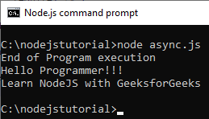
Callback function
Explanation: fs library is loaded to handle file-system related operations. The readFile() function is asynchronous and control return immediately to the next instruction in the program while the function keep running in the background. A callback function is passed which gets called when the task running in the background are finished.
Output:

Slide 65
REST API
Representational State Transfer (REST) is an architectural style that defines a set of constraints to be used for creating web services. REST API is a way of accessing web services in a simple and flexible way without having any processing.
REST technology is generally preferred to the more robust Simple Object Access Protocol (SOAP) technology because REST uses less bandwidth, simple and flexible making it more suitable for internet usage. It’s used to fetch or give some information from a web service. All communication done via REST API uses only HTTP request.

Slide 66
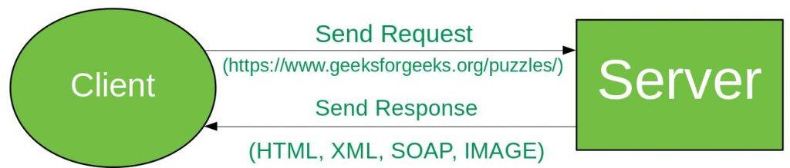
REST API
Working: A request is sent from client to server in the form of a web URL as HTTP GET or POST or PUT or DELETE request. After that, a response comes back from the server in the form of a resource which can be anything like HTML, XML, Image, or JSON. But now JSON is the most popular format being used in Web Services.

Slide 67
REST API
In HTTP there are five methods that are commonly used in a REST-based Architecture i.e., POST, GET, PUT, PATCH, and DELETE. These correspond to create, read, update, and delete (or CRUD) operations respectively. There are other methods which are less frequently used like OPTIONS and HEAD.
GET: The HTTP GET method is used to read (or retrieve) a representation of a resource. In the safe path, GET returns a representation in XML or JSON and an HTTP response code of 200 (OK). In an error case, it most often returns a 404 (NOT FOUND) or 400 (BAD REQUEST).
POST: The POST verb is most often utilized to create new resources. In particular, it’s used to create subordinate resources. That is, subordinate to some other (e.g. parent) resource. On successful creation, return HTTP status 201, returning a Location header with a link to the newly-created resource with the 201 HTTP status.

Slide 68
REST API
PUT: It is used for updating the capabilities. However, PUT can also be used to create a resource in the case where the resource ID is chosen by the client instead of by the server. In other words, if the PUT is to a URI that contains the value of a non-existent resource ID.
PATCH: It is used to modify capabilities. The PATCH request only needs to contain the changes to the resource, not the complete resource. This resembles PUT, but the body contains a set of instructions describing how a resource currently residing on the server should be modified to produce a new version.

Slide 69
REST API
Request and Response
Now we will see how request and response work for different HTTP methods. Let’s assume we have an API(https://www.geeksforgeeks.org/api/students) for all students data of gfg.
GET: Request for all Students.
RequestGET:/api/studentsPOST: Request for Posting/Creating/Inserting Data
Request
POST:/api/students
{“name”:”Raj”}

Slide 70
GraphQL
GraphQL is a query language for your API, and a server-side runtime for executing queries using a type system you define for your data. GraphQL isn't tied to any specific database or storage engine and is instead backed by your existing code and data.
GraphQL is a query language for your API, and a server-side runtime for executing queries using a type system you define for your data. GraphQL isn't tied to any specific database or storage engine and is instead backed by your existing code and data.

Slide 71
GraphQL
Why GraphQL
RESTful APIs follow clear and well-structured resource-oriented approach. However, when the data gets more complex, the routes get longer. Sometimes it is not possible to fetch data with a single request. This is where GraphQL comes handy. GraphQL structures data in the form of a graph with its powerful query syntax for traversing, retrieving, and modifying data.
The following are advantages of using GraphQL query Language −
Ask for what you want − and get it
Send a GraphQL query to your API and get exactly what you need. GraphQL queries always return predictable results. Applications using GraphQL are fast and stable. Unlike Restful services, these applications can restrict data that should be fetched from the server.

Slide 72
Introduction: Callback functions are used for Asynchronous events. Whenever any asynchronous event has to take place it is generally preferred to use callbacks (if data is not nested or inter-dependent). What are Promises A promise is an advancement of callbacks in Node. In other words, a promise is a JavaScript object which is used to handle all the asynchronous data operations. While developing an application you may encounter that you are using a lot of nested callback functions.
Promises in Node.js

Slide 73
Promises in Node.js
dboper.insertDocument(db, { name: "Test", description: "Test"},
"test", (result) => {
console.log("Insert Document:\n", result.ops);
dboper.findDocuments(db, "test", (docs) => {
console.log("Found Documents:\n", docs);
dboper.updateDocument(db, { name: "Test" },
{ description: "Updated Test" }, "test",

Slide 74
Promises in Node.js
(result) => {
console.log("Updated Document:\n", result.result);
dboper.findDocuments(db, "test", (docs) => {
console.log("Found Updated Documents:\n", docs);
db.dropCollection("test", (result) => {
console.log("Dropped Collection: ", result);
client.close();
});
});
});
});
});

Slide 75
Promises in Node.js
This is what happens due to the nesting of callback functions. Now imagine if you need to perform multiple nested operations like this. That would make your code messy and very complex. In Node.js world, this problem is called “Callback Hell”.
To resolve this issue we need to get rid of the callback functions whilst nesting. This is where Promises come into the picture. A Promise in Node means an action which will either be completed or rejected. In case of completion, the promise is kept and otherwise, the promise is broken. So as the word suggests either the promise is kept or it is broken. And unlike callbacks, promises can be chained.

Slide 76
Promises in Node.js
Callbacks to Promises Promises notify whether the request is fulfilled or rejected. Callbacks can be registered with the .then() to handle fulfillment and rejection. The .then() can be chained to handle the fulfillment and rejection whereas .catch() can be used for handling the errors(if any).
dboper.insertDocument(db,
{ name: "Test", description: "Just a test"},
"test").then((result) => {
console.log("Insert Document:\n", result.ops);
});

Slide 77
Promises in Node.js
Nested Promises: Often you will encounter situations where you need to make use of nested Promises. Nested promises begin with a .then() and in each of the .then() we have a return statement. After the return statement, .then() follows in the same manner. Following example shows the worst case scenario wherein multiple .then() methods are used in order to declare nested promises (which are dependent on each other for their own execution).

Slide 78
Node.js Promise Chaining
Promise chaining: Promise chaining is a syntax that allows you to chain together multiple asynchronous tasks in a specific order. This is great for complex code where one asynchronous task needs to be performed after the completion of a different asynchronous task.
To demonstrate promise chaining, the following function will be used to simulate an asynchronous task. In reality, it’s just adding up a couple of numbers, waiting two seconds, and fulfilling the promise with the sum.

Slide 79
Node.js Promise Chaining
const add = (a, b) => {
return new Promise((resolve, reject) => {
setTimeout(() => {
if (a < 0 || b < 0) {
return reject('Numbers must be non-negative')
}
resolve(a + b)
}, 2000)
})
}

Slide 80
Node.js Promise Chaining
add(1, 2).then((sum) => {
console.log(sum) // Print 3
return add(sum, 4)
}).then((sum2) => {
console.log(sum2) // Print 7
}).catch((e) => {
console.log(e)
});

Slide 81
Template engines
Template engines are used when you want to rapidly build web applications that are split into different components. Templates also enable fast rendering of the server-side data that needs to be passed to the application.
Template engines are mostly used for server-side applications that are run on only one server and are not built as APIs. The popular ones include Ejs, Jade, Pug, Mustache, HandlebarsJS, Jinja2, and Blade.

Slide 82
Daily Quiz
Q 1 -. Which of the following statements are true?
A Node.js is a server side language.
B Node.js is a client side language.
C Node.js is a both server and client side language.
D None of the above.
Q2-) Node.js is written in which language?
A -C
B –C++
C -Java
D -JavaScript
Q 3 - Which of the following are examples of node modules?
Express
Body-parser
Socket.io
All of the above

Slide 83
Daily Quiz
Q 4 -) To include the HTTP server in the node module, what function do we use?
A get()
B require()
C createServer()
D None of the above
Q5-) To include the HTTP server in the node module, what function do we use?
A Export
B Expose
C Require
D None of the above
Q 6 -) Default scope in Node.js application is?
A Global
B Local
C Local to objects
D None of the above

Slide 84
Weekly Assignment
What is Node.Js.
What is the various module present in Node.Js.
Describe the steps to install Node.Js in windows.
Elaborate promises in Node.Js.
Discuss Callback function in Node.Js.

Slide 85
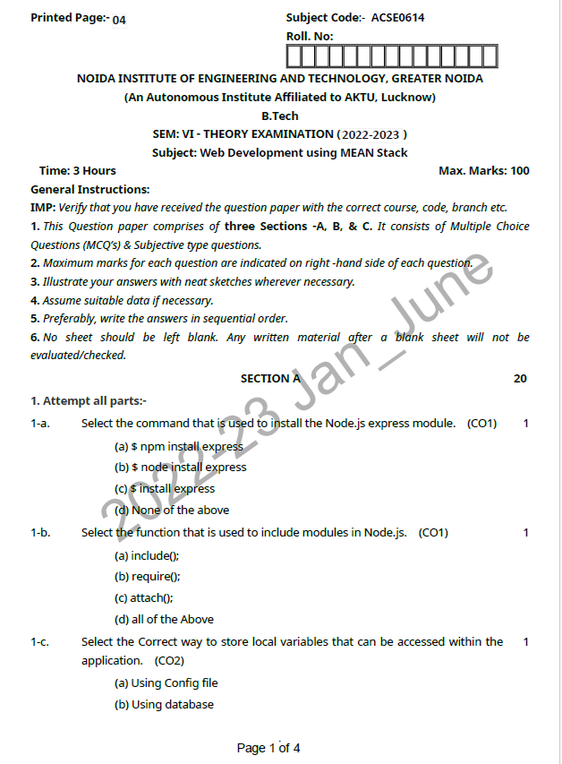
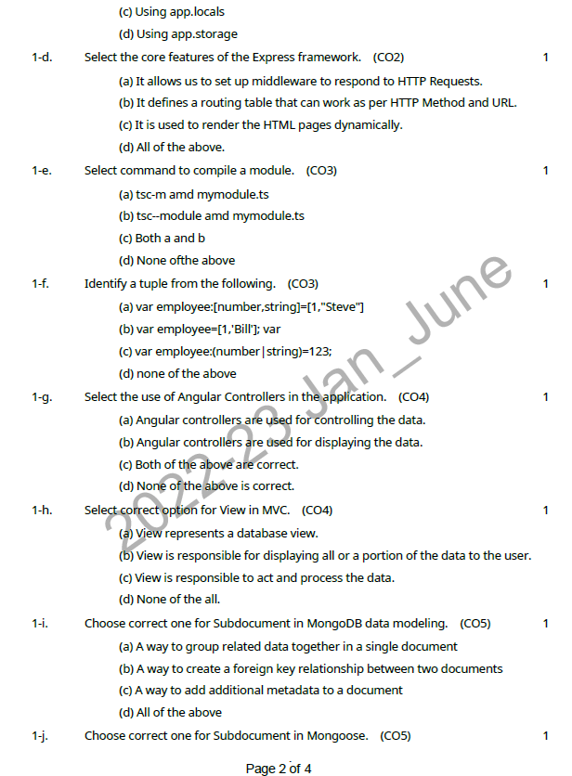
Previous Year Question paper

Slide 86
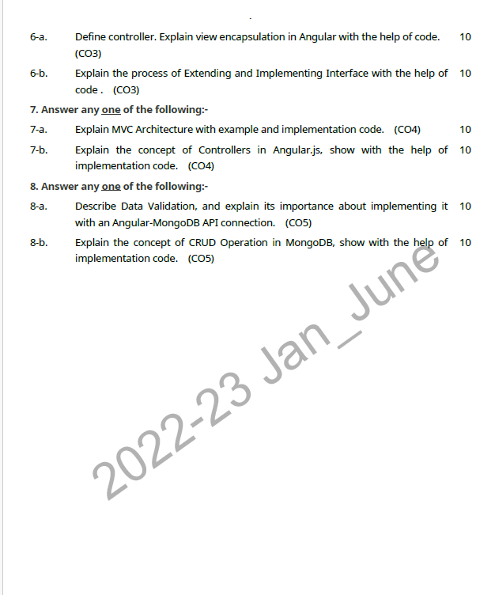
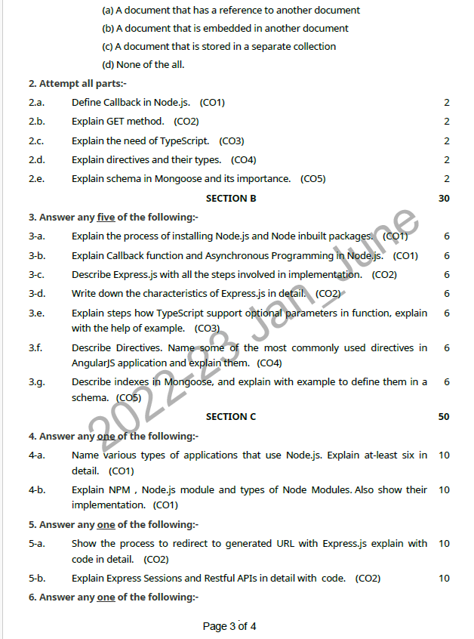
Previous Year Question paper(Contd…)

Slide 87
Topic Link ( YouTube & NPTEL Video Links)
YouTube /other Video Links
https://youtu.be/rI4kdGLaUiQ?list=PL6n9fhu94yhUbctIoxoVTrklN3LMwTCmd
https://youtu.be/v9ejT8FO-7I?list=PLrhzvIcii6GNjpARdnO4ueTUAVR9eMBpc
https://youtu.be/VGLjQuEQgkI?list=PLt4nG7RVVk1h9lxOYSOGI9pcP3I5oblbx

Slide 88
MCQ (End of Unit)
1 Which of the following is true about package.json?
package.json is present in the root directory of any Node application/module.
package.json is used to define the properties of a package.
package.json can be used to update dependencies of a Node application.
All of the above.
2. Which of the following is true about writable stream?
writable stream is used for write operation.
Output of readable stream can be input to a writable stream.
Both of the above.
None of the above.

Slide 89
MCQ (End of Unit)
3. Which of the following is true about fs module of Node?
Every method in fs module have synchronous as well as asynchronous form.
Asynchronous methods of fs module take last parameter as completion function callback and first parameter of the callback function as error.
Both of the above.
None of the above.
4. Which method of fs module is used to delete a file?
fs.delete(fd, len, callback)
fs.remove(fd, len, callback)
fs.unlink(path, callback)
None of the above.

Slide 90
Glossary Questions
Top 10 Node.Js interview questions
How NodeJs works for server side?
How is Node.Js useful for the client and server side programming?
Explain the benefits of Node.Js.
Describe the file module in Node.Js.
Discuss the various module in Node.Js.
What is callback function in Node.Js?
What is GraphQL?
What is Promise Chaining?
Describe the significance of promises in Node.Js.
What are Template engine?

Slide 91
Expected Questions for University Exam
How NodeJs works for server side?
How is Node.Js useful for the client and server side programming?
Explain the benefits of Node.Js.
Describe the file module in Node.Js.
Discuss the various module in Node.Js.
What is callback function in Node.Js?
What is GraphQL?
What is Promise Chaining?
Describe the significance of promises in Node.Js.
What are Template engine?

Slide 92
Summary
Till Now we understand, How to Install Node.js and NPM on Windows and Mac. Smalltalk MVC, what are the model ,view and controller defined by small talk, design pattern in The catalog, we learn how to organized the catalog, learn how to solve real world problems with design patterns, what are the approaches and Patterns that help in real world problem , how to choose best pattern and what are uses of the patterns.
The Principle of Least knowledge, also known as The law of Demeter, or more precisely, the Law of Demeter for Functions/Methods (LoD-F) is a design principle which provides guidelines for designing a system with minimal dependencies.

Slide 93
References
Simon Holmes, Clive Herber, “Getting MEAN with Mongo, Express, Angular, and Node”, 2nd Edition 2016, Addison Wesley Publication.
Dhruti Shah, “Comprehensive guide to learn Node.js”, 1st Edition, 2018 BPB Publications.
Christoffer,Noring,Pablo,Deeleman,“Learning Angular”,3rd Edition,2017 Packt publications. .
Peter Membrey, David Hows, Eelco Plugge, “MongoDB Basics”, 2nd edition, 2018, International Publication.
Christoffer Noring, Pablo Deeleman, “Learning Angular”,3rd Edition,

Slide 94
THANK YOU

